Slide 1



Abdullah Imran
Home
Service
About Me
Contact
Search . . . .
COSMI CODE
MACHINE LEARNING INTERNSHIP
Hand Gesture
Recognition

Slide 2
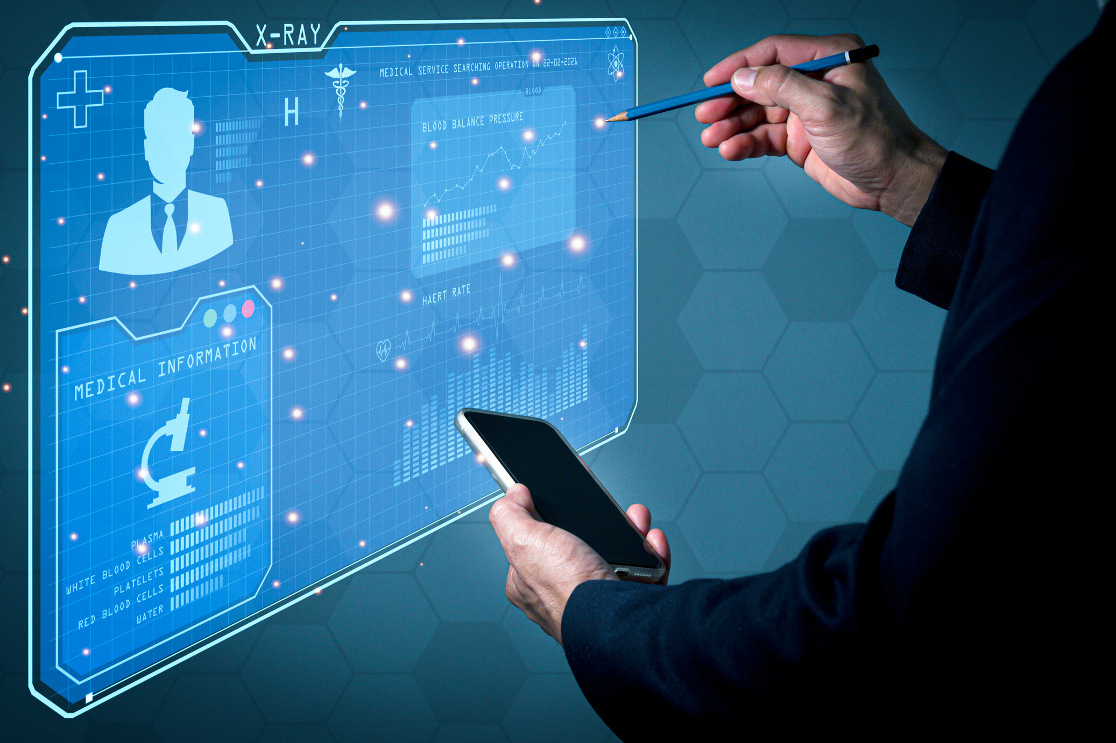
WEEK-6 Task
About Project
Developed an AI-powered Hand Gesture Recognition system using deep learning techniques, specifically designed to recognize various hand gestures in real time. The model is capable of interpreting different gestures with high accuracy, making it suitable for diverse applications such as sign language interpretation, contactless control, and interactive gaming.
GITHUB REPOSITORY LINK

Slide 3
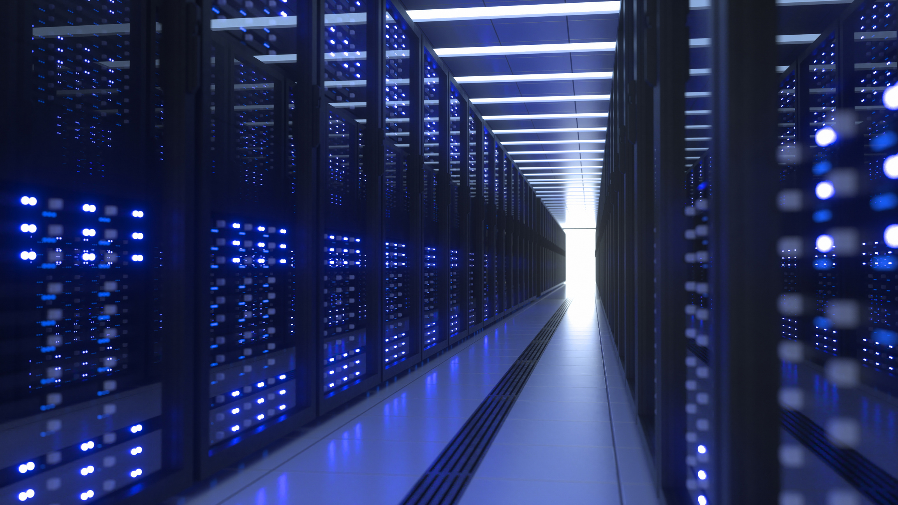
Key Steps in the Project
Data Preparation:
Gathered a large dataset of hand gesture images.
Applied augmentation techniques (rotation, flipping, scaling) to improve the dataset diversity and robustness.
Model Development:
Designed and trained a Convolutional Neural Network (CNN) to identify and classify gestures.
Integrated Class Activation Maps (CAM) for visual feedback, highlighting which parts of the image influenced the model's predictions.
3. 🌐 Deployment Across Multiple Platforms:
Streamlit: Created a simple and interactive web page with a user-friendly interface for easy gesture prediction. 📱
Dash: Developed a more sophisticated dashboard-style app featuring rich analytics and visualizations to better understand model performance. 📊
Flask: Built a traditional web app with enhanced customization, allowing more flexibility in deployment and user interaction. 🖥️

Slide 4
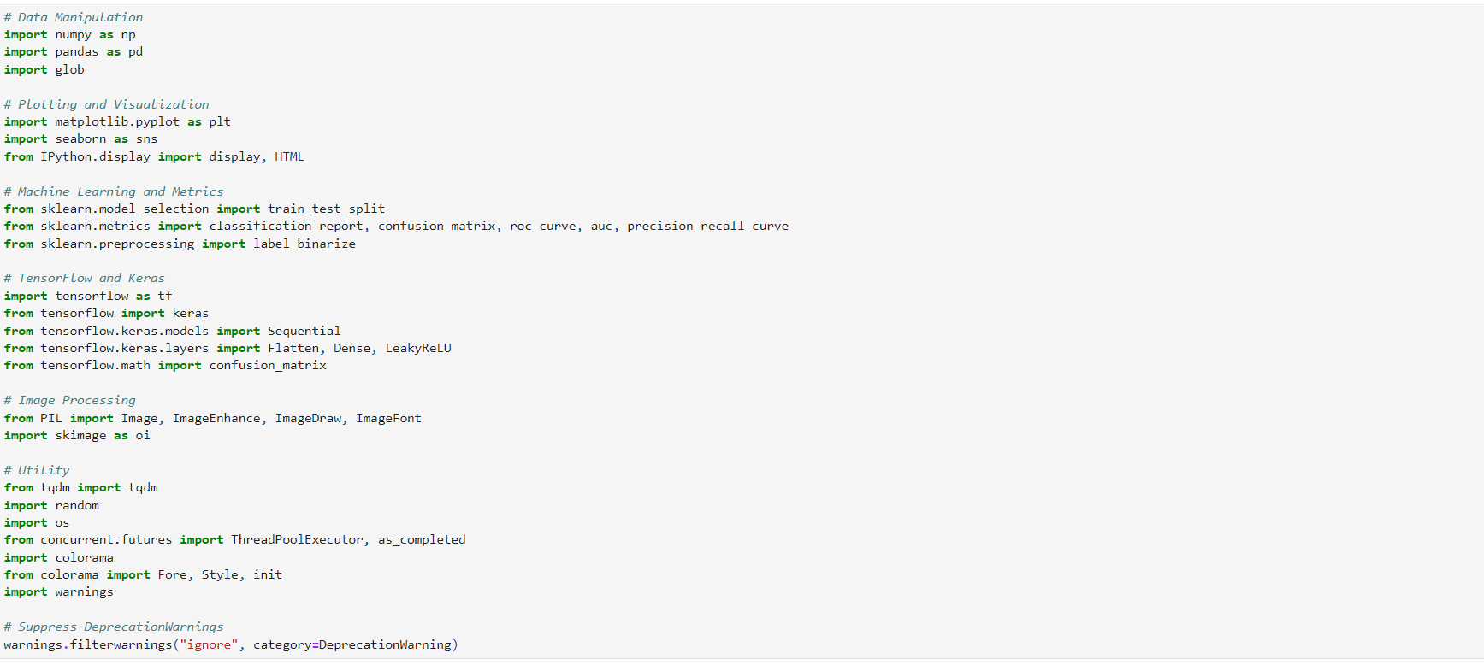
Importing Libraries

Slide 5
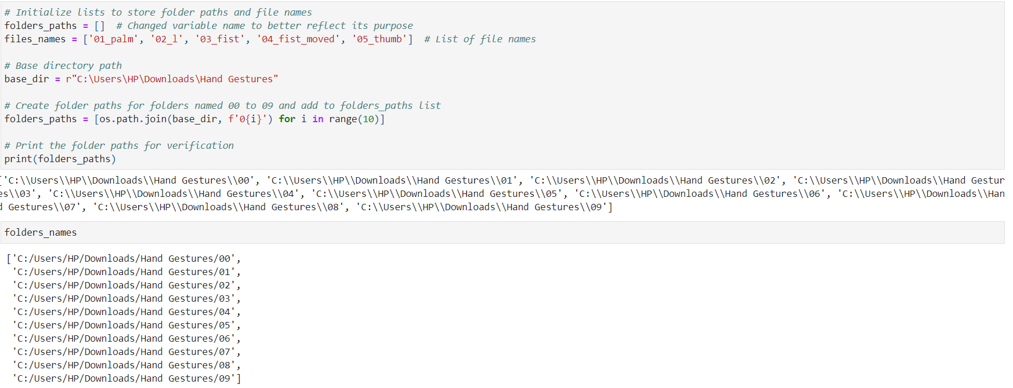
EXPLORATORY DATA ANALYSIS

Slide 6
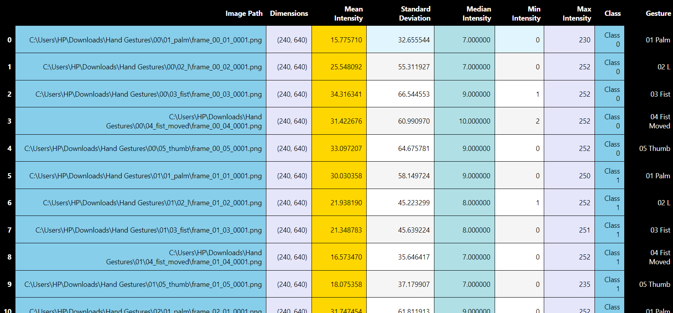
SUMMARY STATISTICS OF DATA

Slide 7
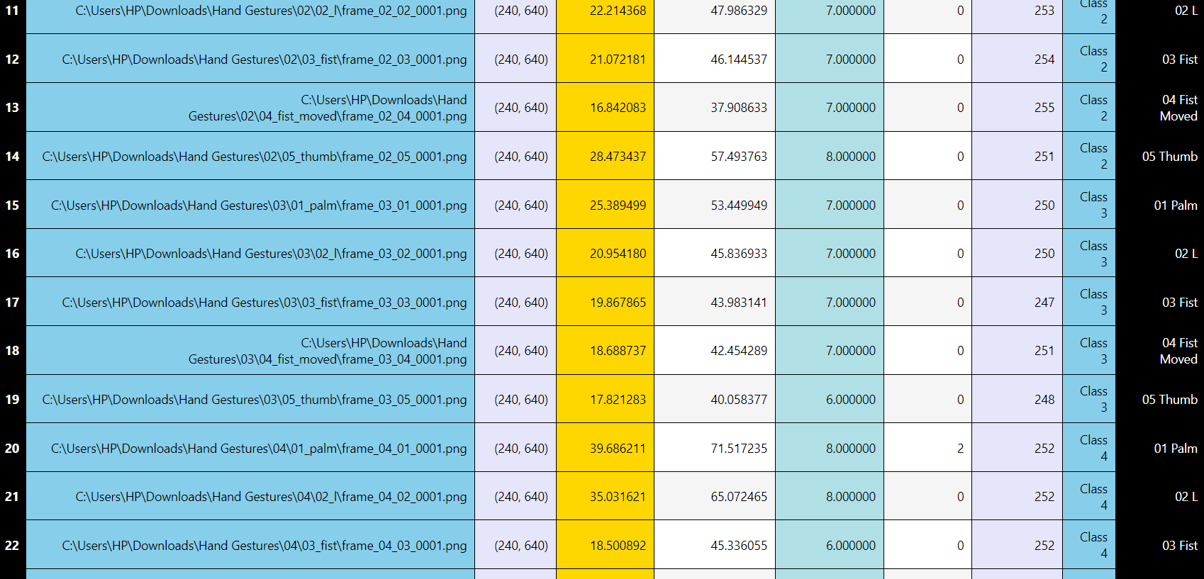

Slide 8
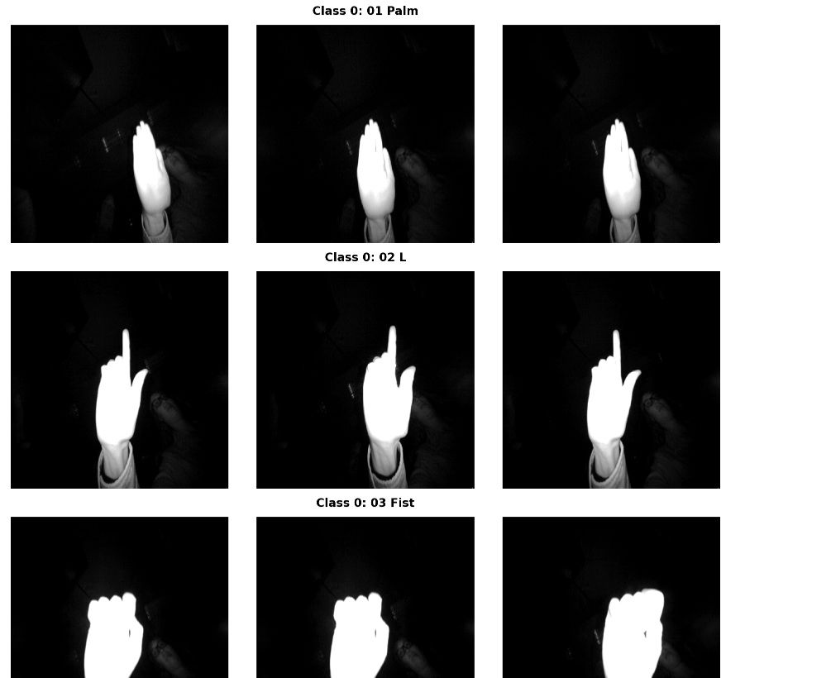
DISPLAYING PICTURES OF DATA

Slide 9
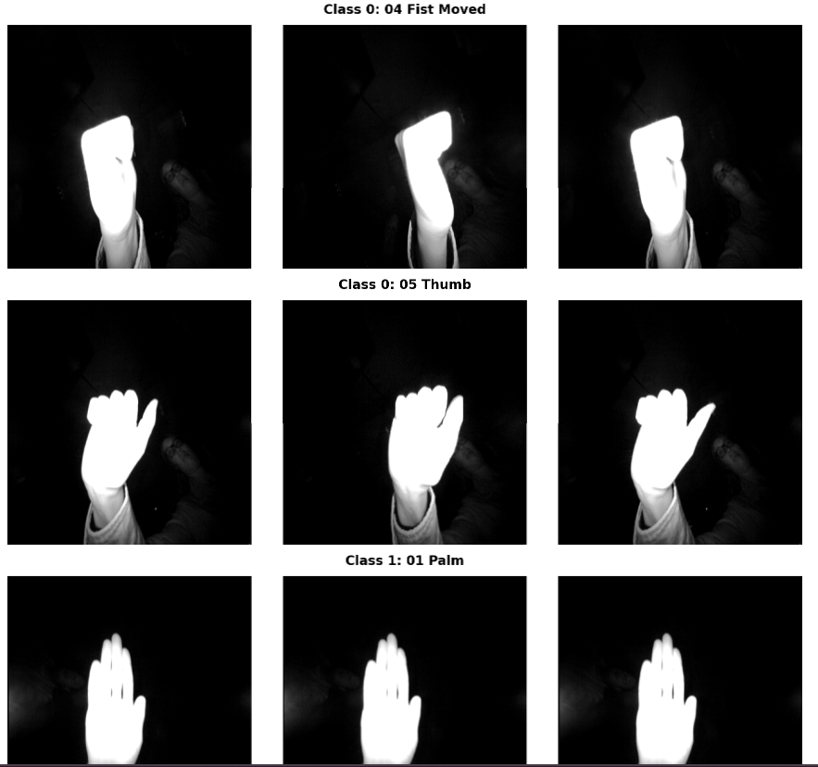

Slide 10
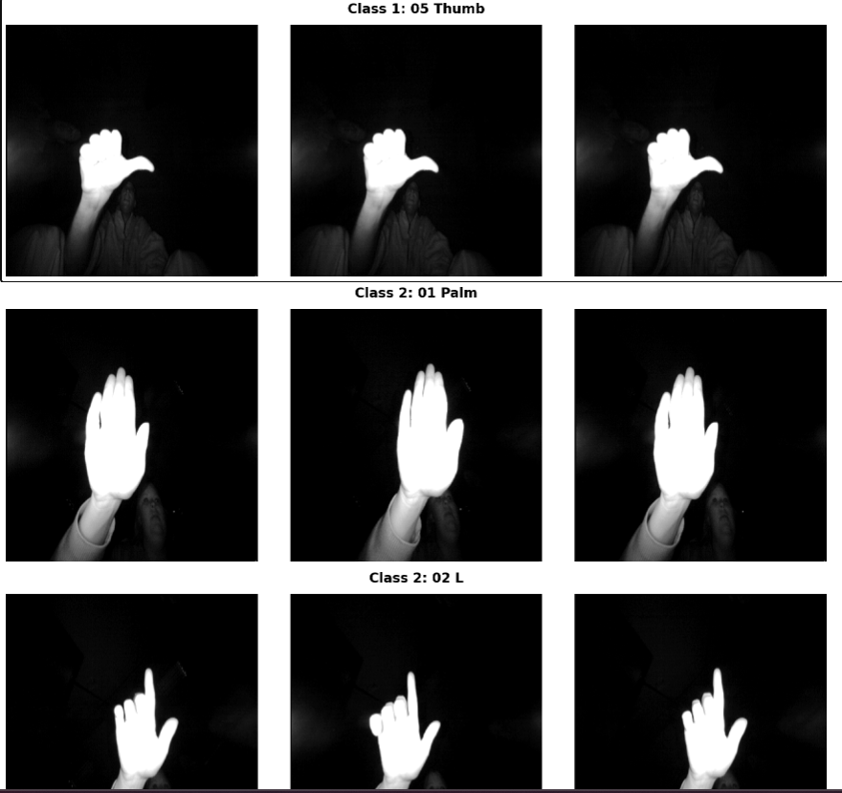

Slide 11
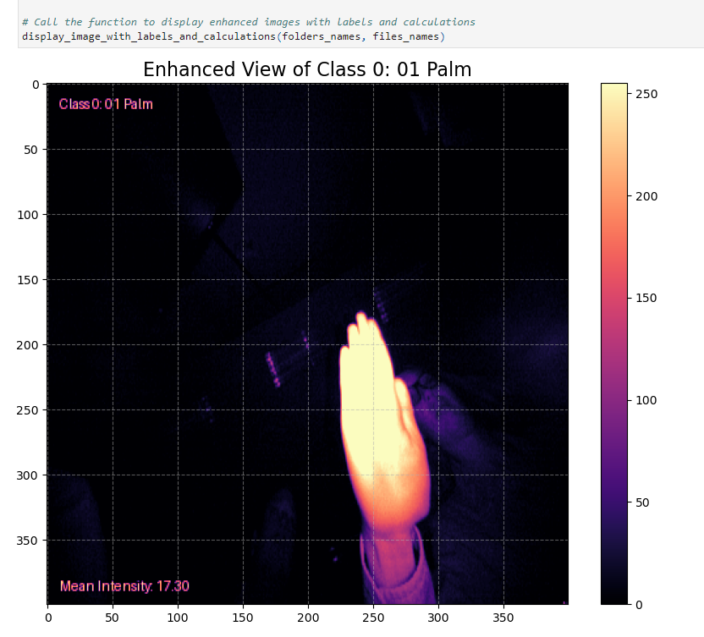
DETAILED STATISTICS OF IMAGES

Slide 12
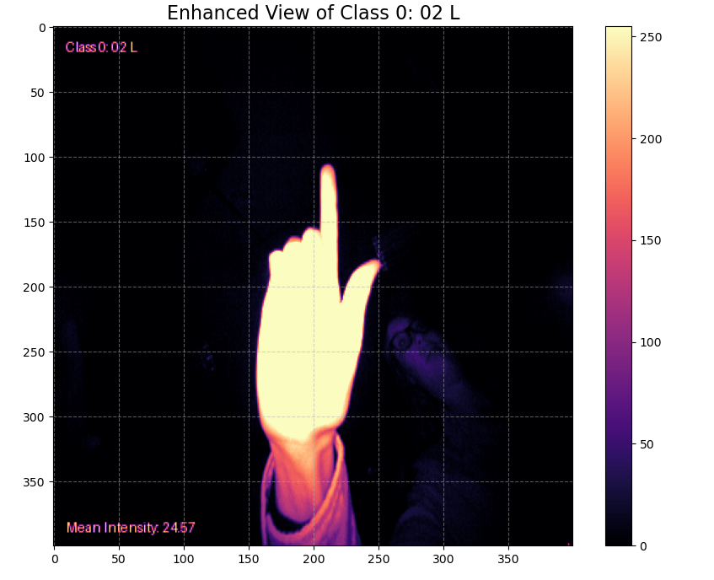
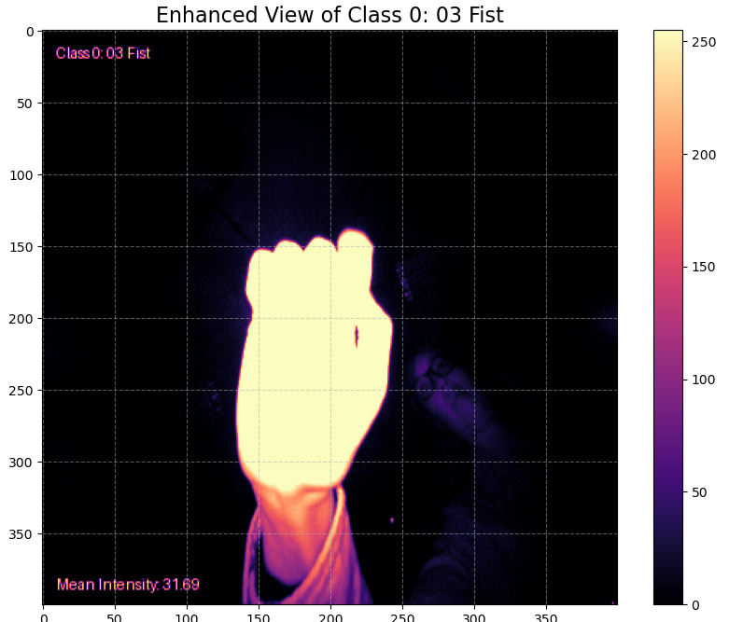
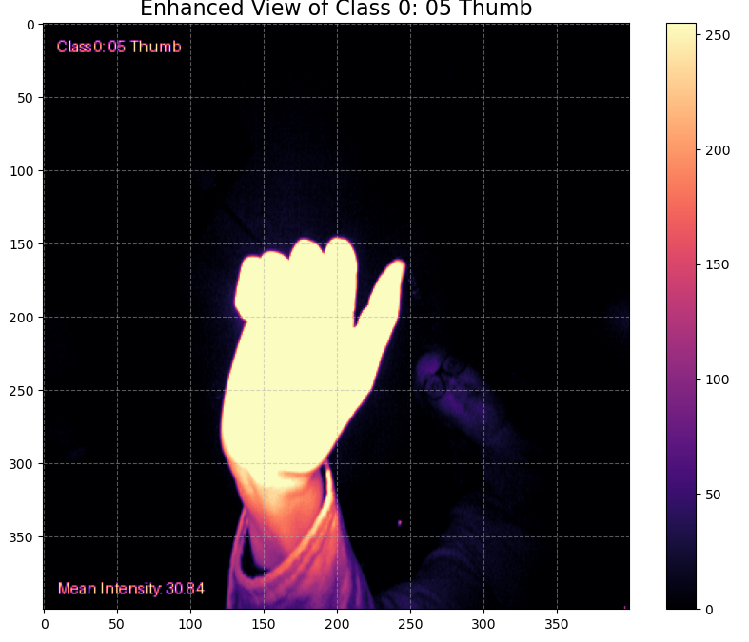
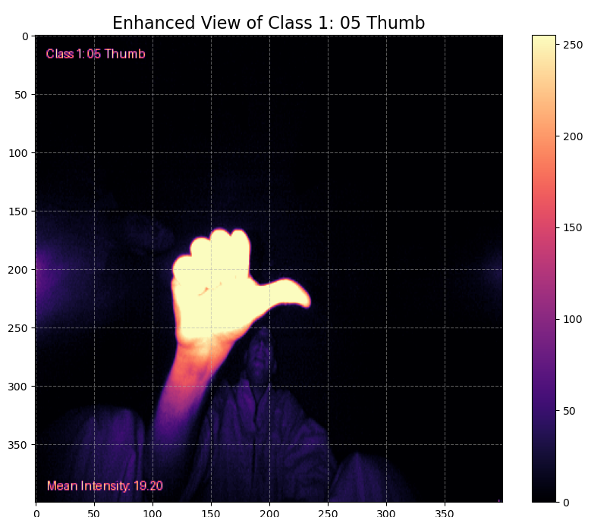

Slide 13
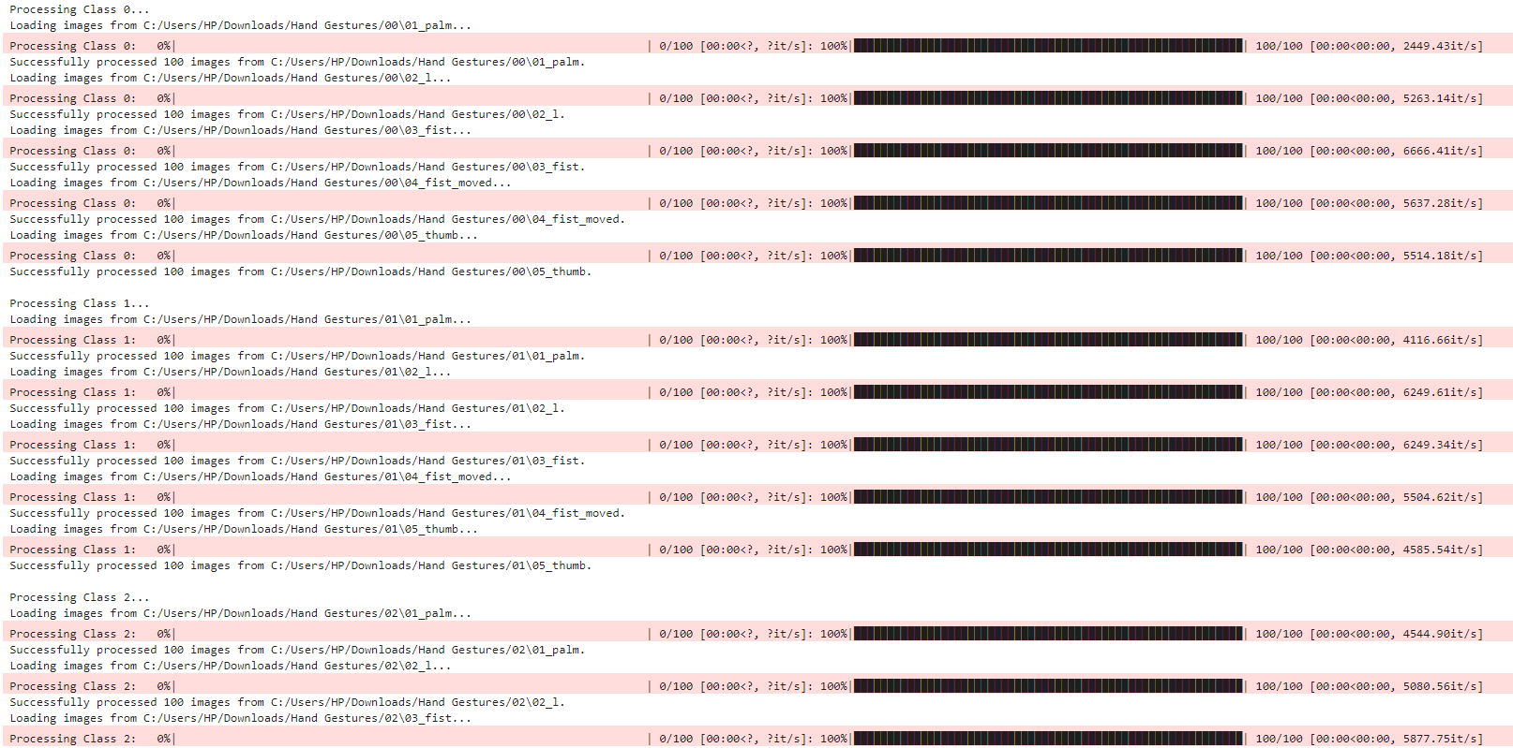
DATA LOADING & PROCESSING

Slide 14
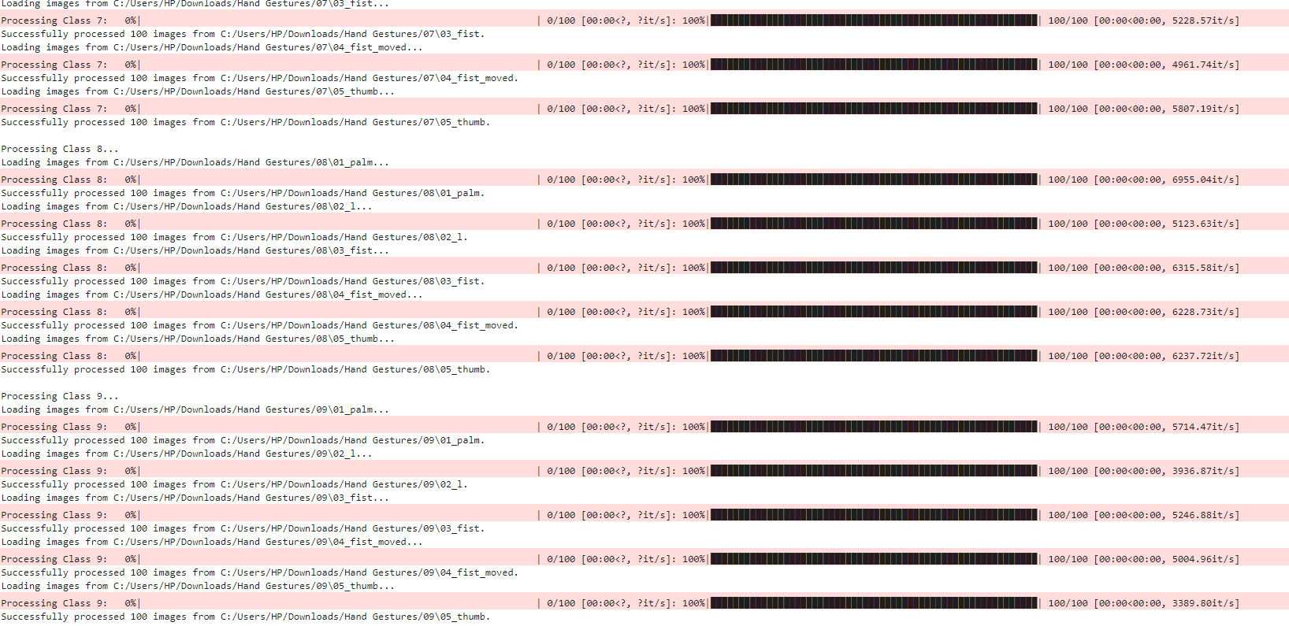

Slide 15
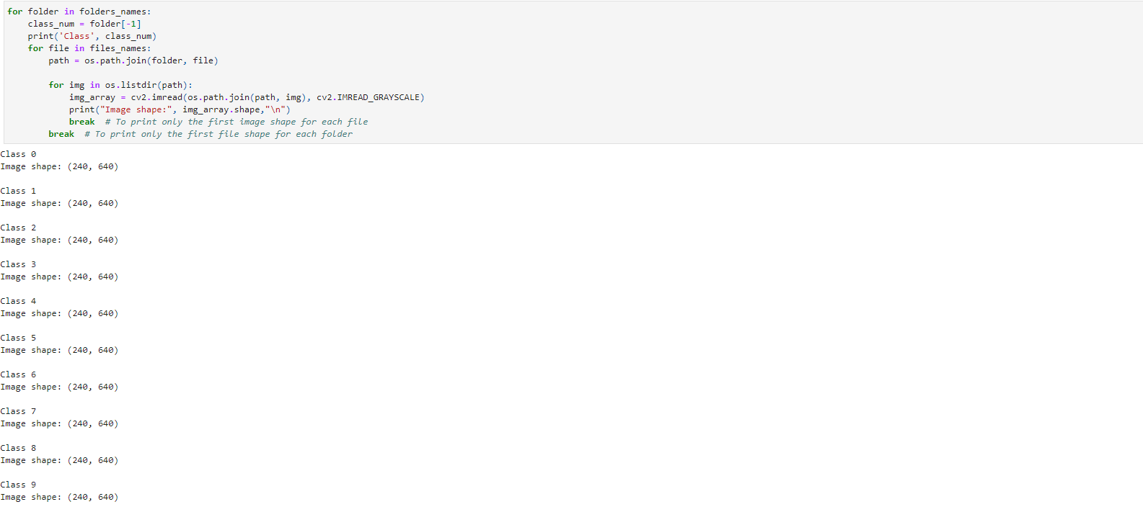
CHECKING SHAPE OF DATA

Slide 16
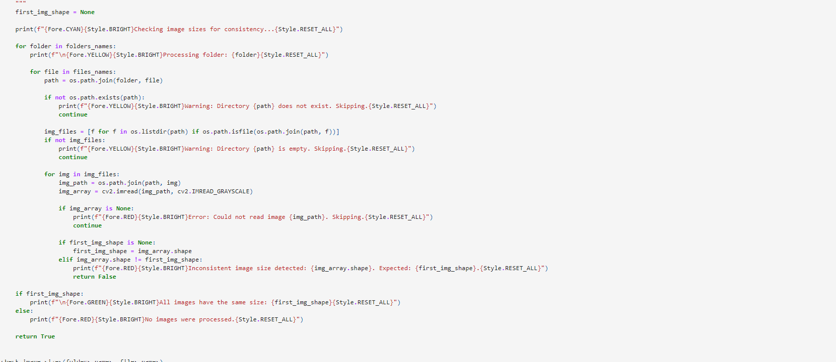
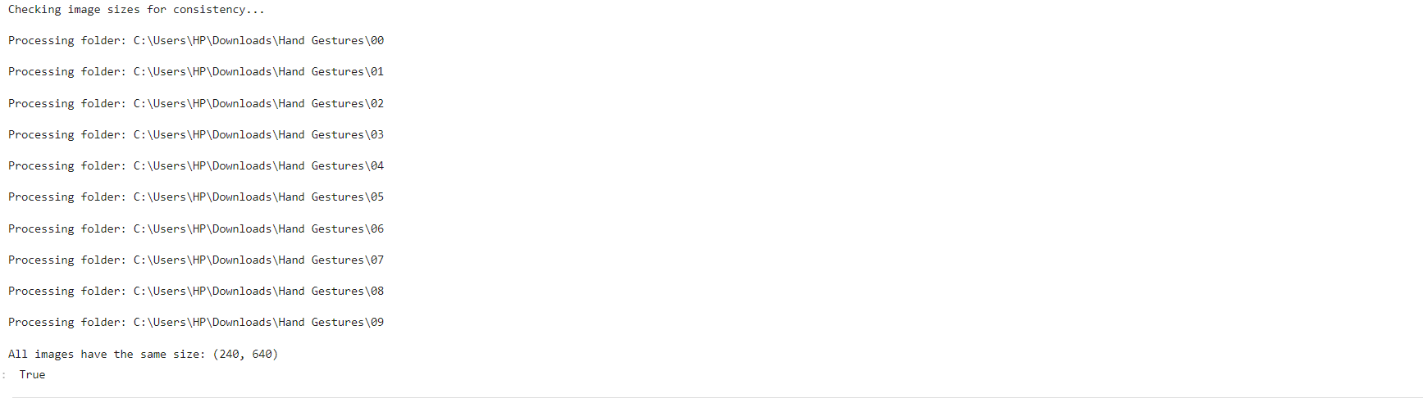

Slide 17
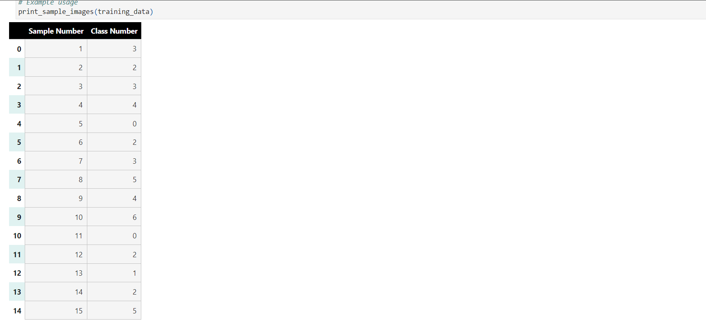
CHECKING SAMPLES OF DATA

Slide 18
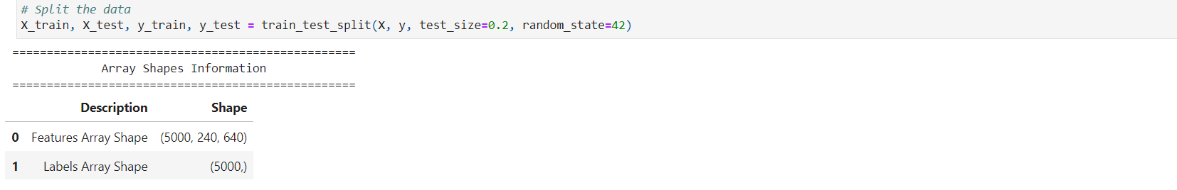
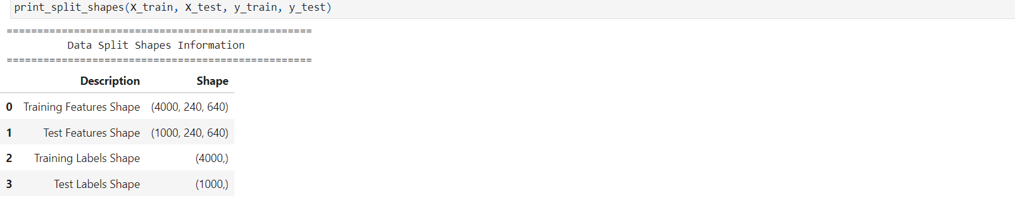
DATA SEPARATION & SPLITTING

Slide 19
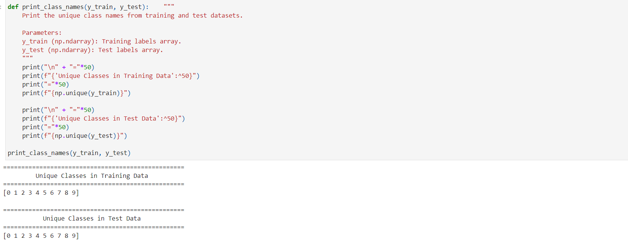
UNIQUE CLASSES OF DATA

Slide 20
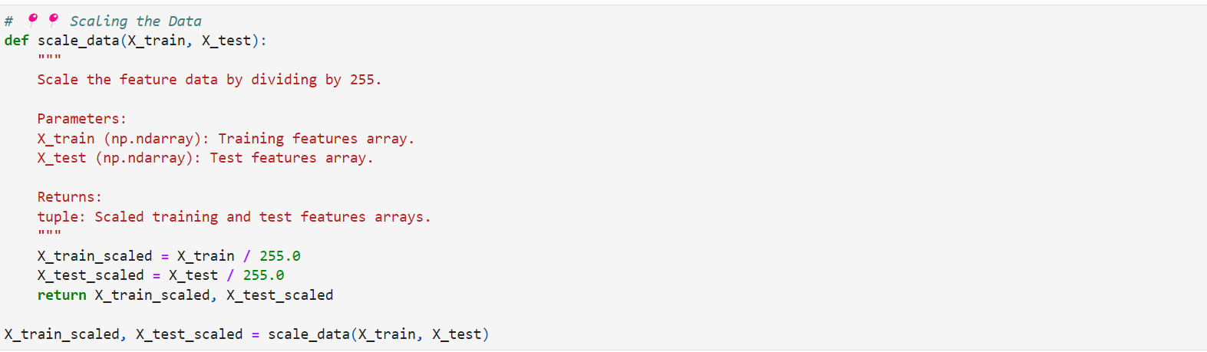
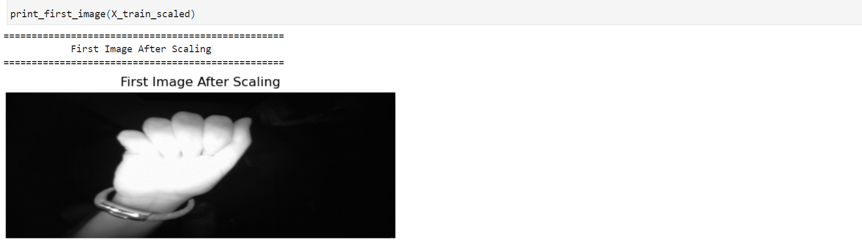
NORMALIZATION

Slide 21
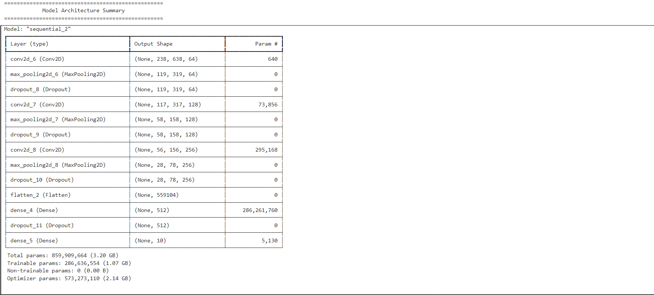
MODEL ARCHITECTURE

Slide 22
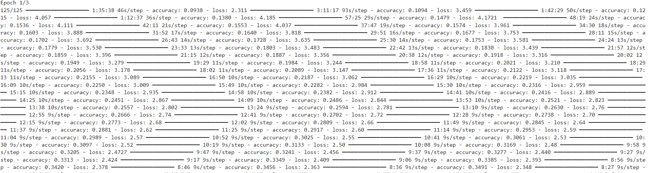
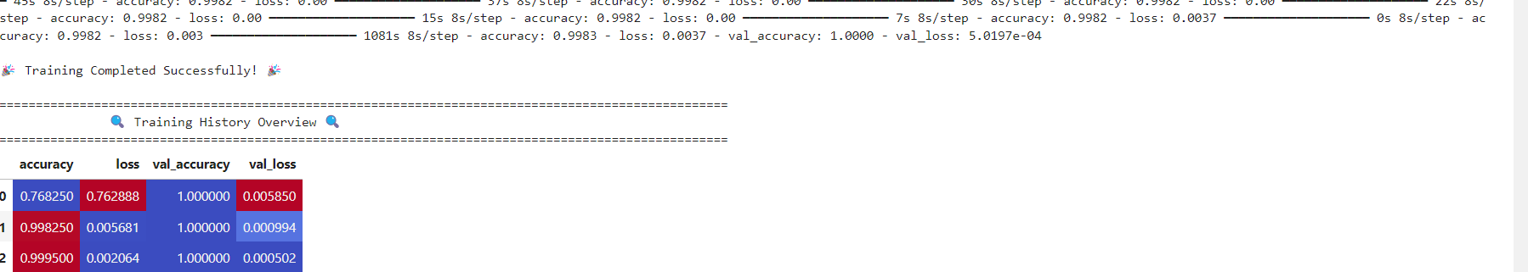
HISTORY OF MODEL
TRAINING

Slide 23
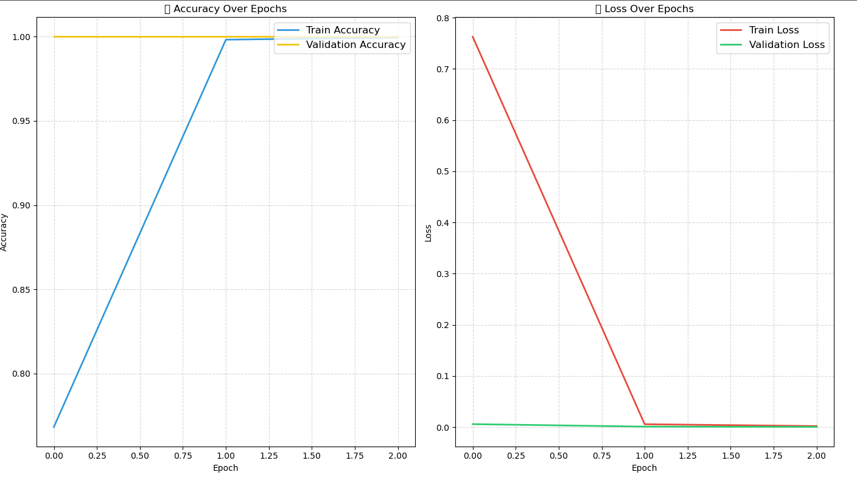
PLOTTING OF LOSS
ACCURACY

Slide 24
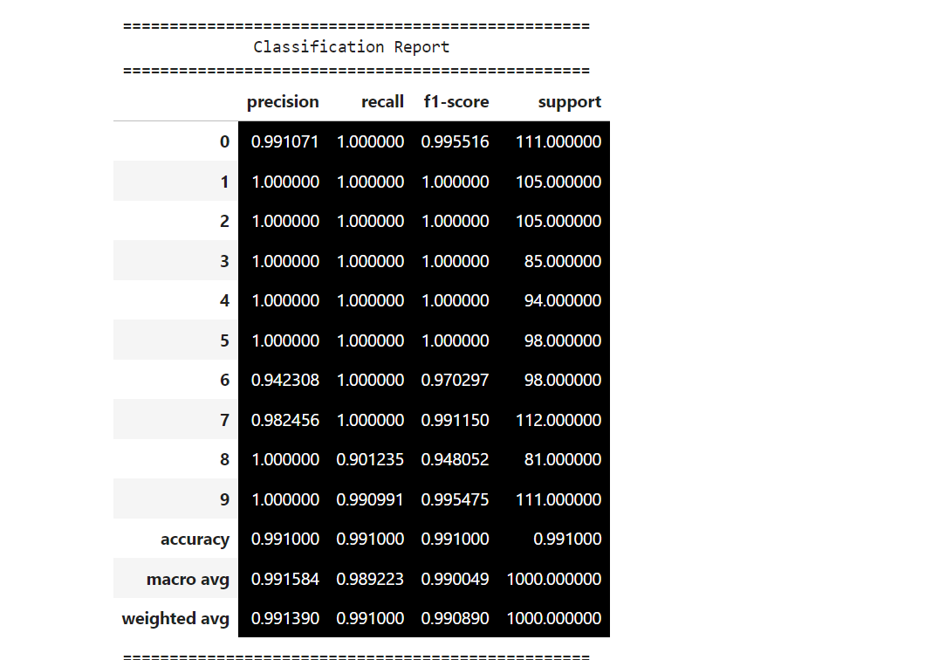
CLASSIFICATION
REPORT

Slide 25
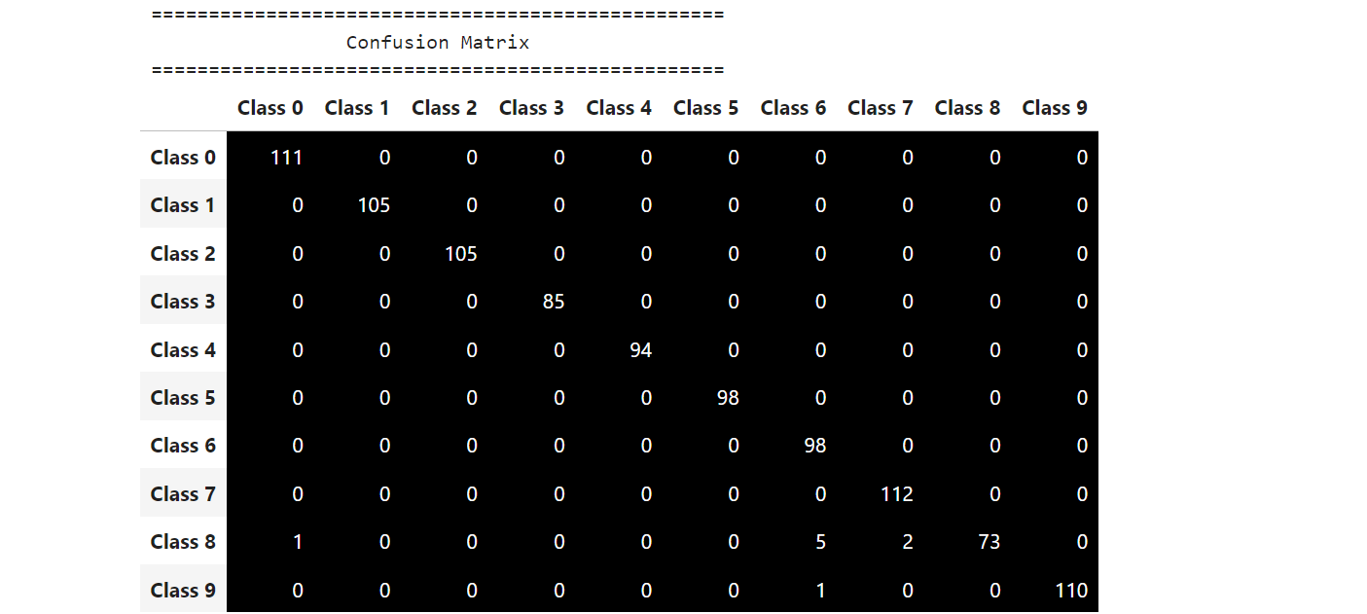
CONFUSION MATRIX

Slide 26
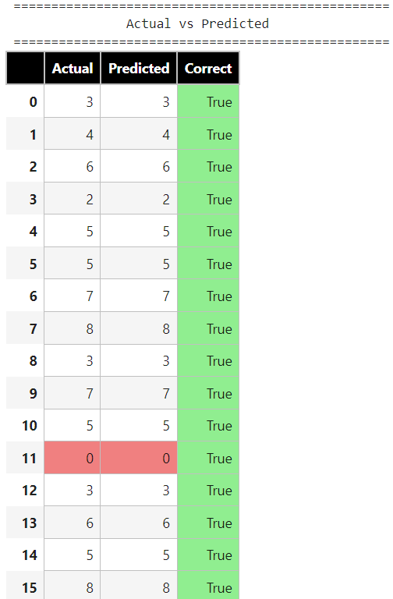
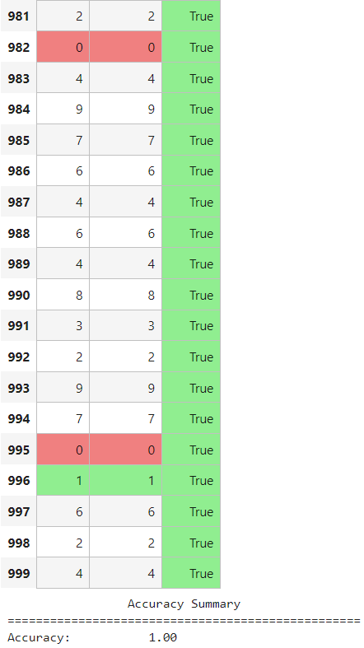

Slide 27
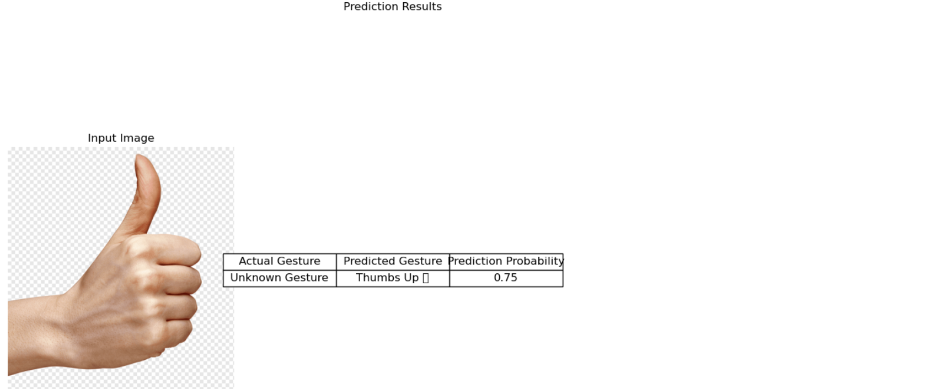
PREDICTION : 1
---------------------------------THUMBS - UP-----------------------------------

Slide 28
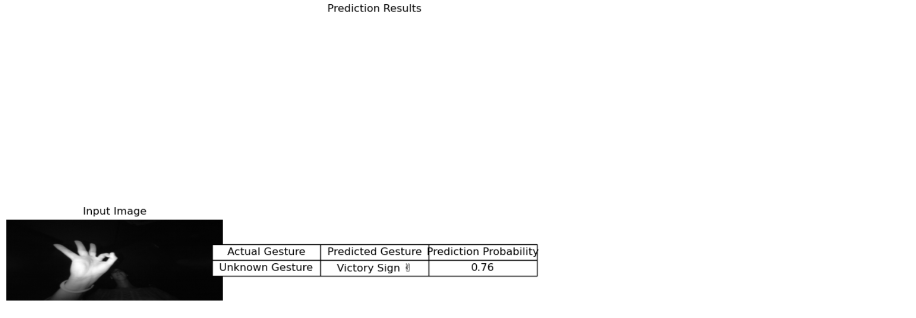
PREDICTION : 2
----------------------------------VICTORY SIGN------------------------------------

Slide 29
🌐 Web Interfaces for Hand Gesture Recognition
Explore the web pages created for the Hand Gesture Recognition project using three popular frameworks: Streamlit, Flask, and Dash.
Each framework provides a unique approach to deploying your model and offering an interactive user experience.
Streamlit
Streamlit is a powerful framework for quickly creating interactive web applications for machine learning and data science projects.
Key Features:
Easy to use with minimal code.
Real-time updates and interactive widgets.
Ideal for creating data-centric apps with simple UI requirements.
Web Page:
Functionality: Allows users to upload a grayscale image and get immediate gesture classification results.

Slide 30
Flask
Flask is a lightweight web framework for Python that is flexible and easy to extend.
Key Features:
Great for creating RESTful APIs and web services.
Flexible architecture for complex web applications.
Integrates well with other libraries and technologies.
Web Page:
Functionality: Provides a form for image upload and displays the classification result after processing the image on the server.
Dash
Dash is a web framework for building analytical web applications. It's built on top of Flask and Plotly, making it ideal for interactive visualizations.
Key Features:
Combines interactive UI elements with analytical capabilities.
Built-in support for Plotly graphs and data visualizations.
Suitable for creating complex dashboards and data-driven apps.
Web Page:
Functionality: Offers a dashboard interface where users can upload images and visualize predictions along with other analytical insights

Slide 31
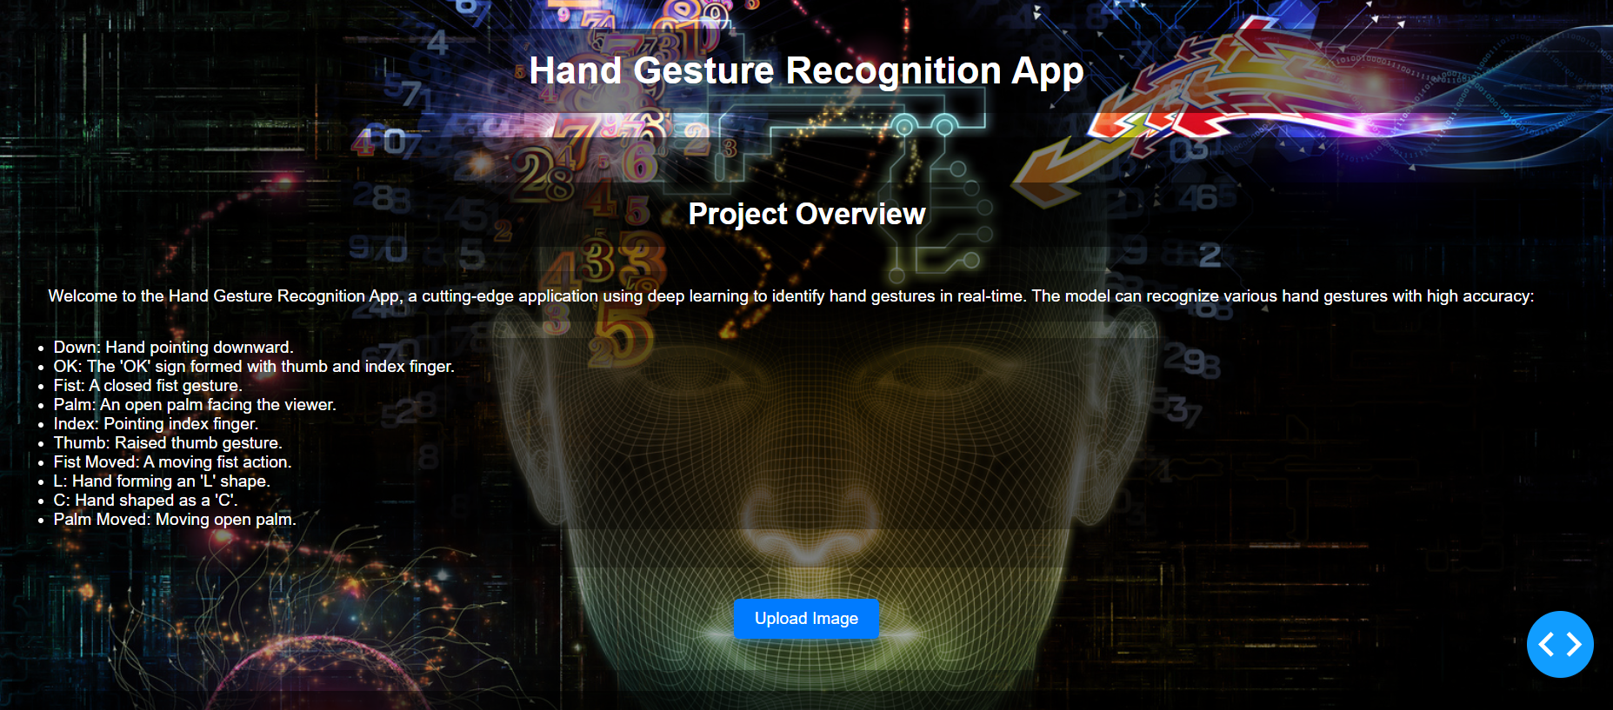
DASH WEBPAGE

Slide 32
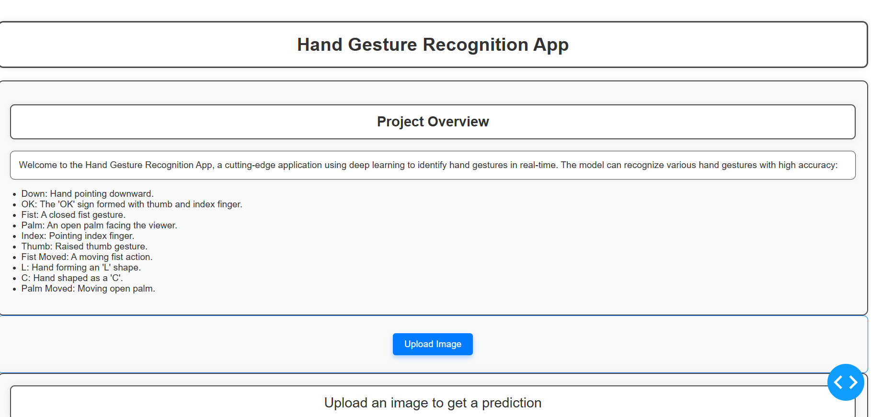
FLASK WEBPAGE

Slide 33
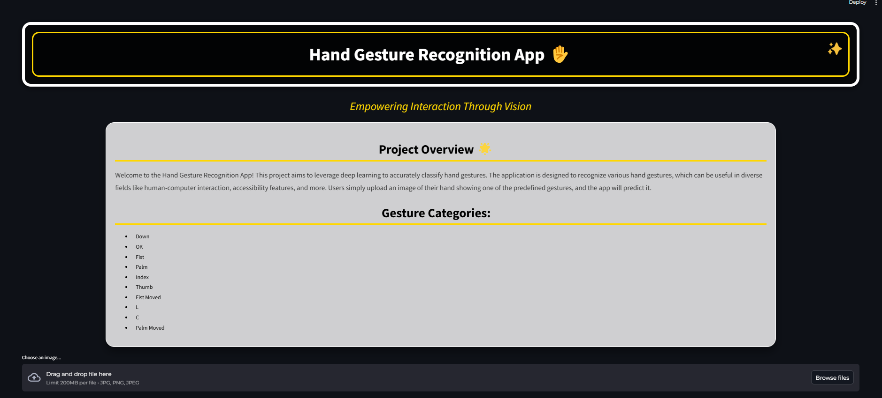
STREAMLIT WEBPAGE

Slide 34
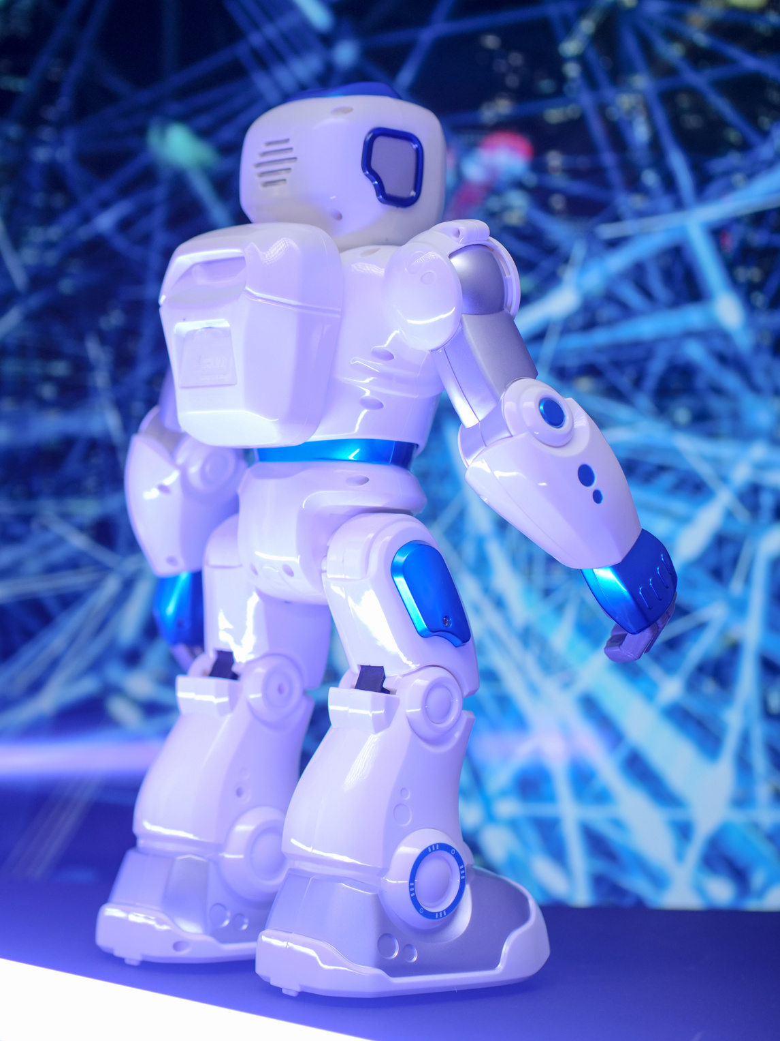
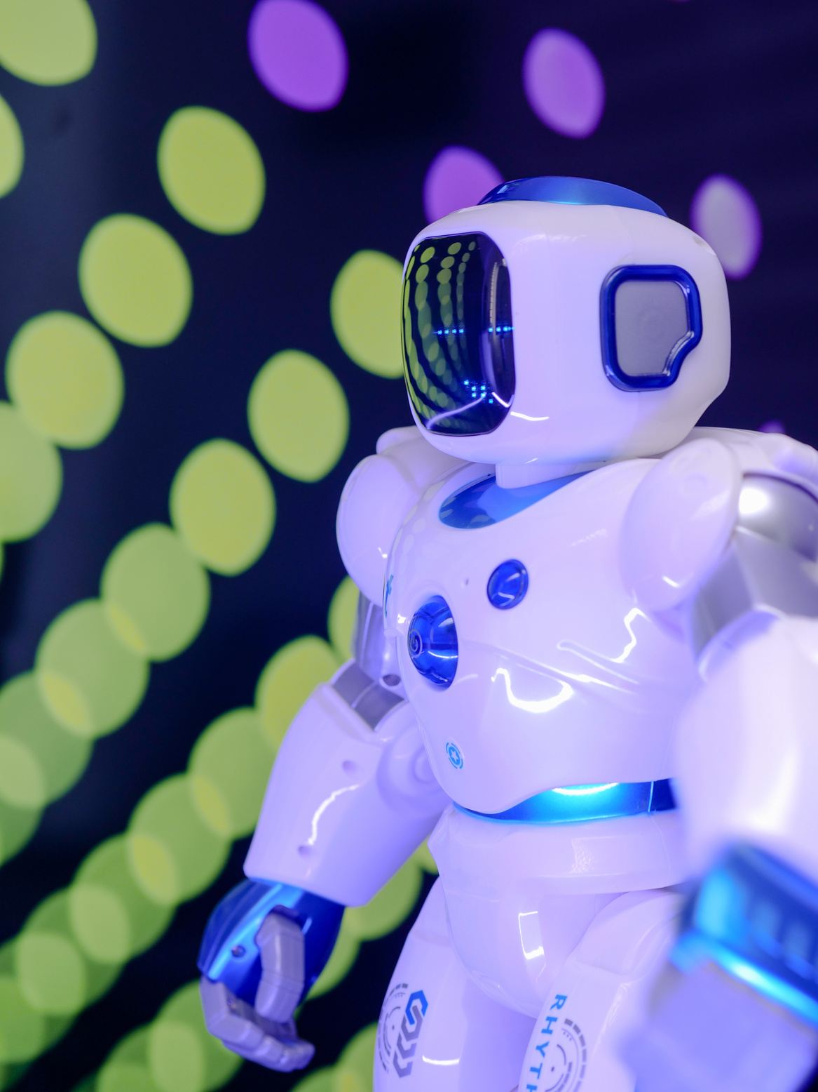
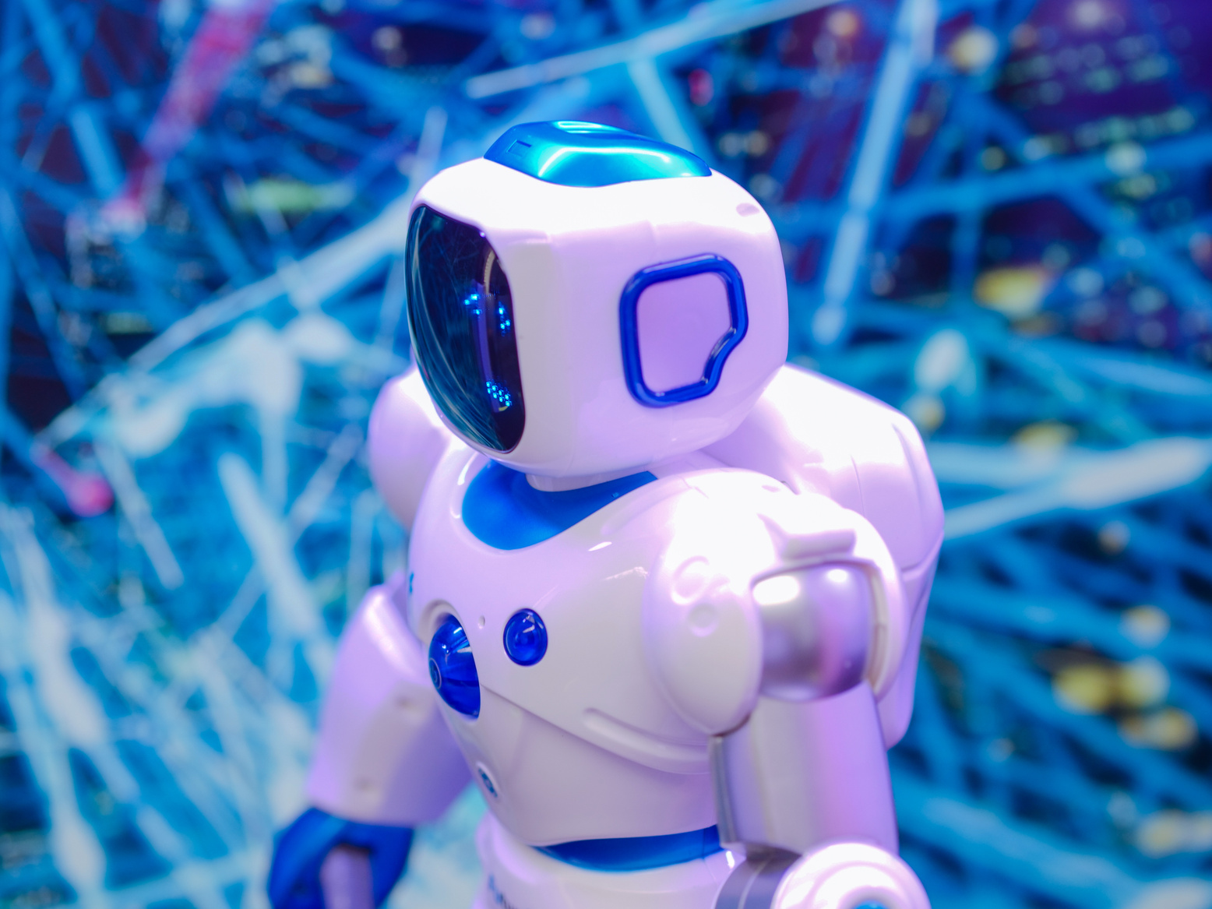

Contact ME
+92 3164009363
abdullahimran017@gmail.com

Slide 35
Thank You
For Watching

